Slide 1


Lecture 6 Handling Errors
18.4.2023
Iflaah Salman

Slide 2
Handling Errors
Raising and handling errors functionally!
Throwing exceptions is a side effect.
Represent failures and exceptions with ordinary values.
Enables writing higher-order functions
abstract out common patterns of error handling and recovery.
The functional solution:
Returning errors as values
is safer
retains referential transparency,
and through the use of higher-order functions.

Slide 3
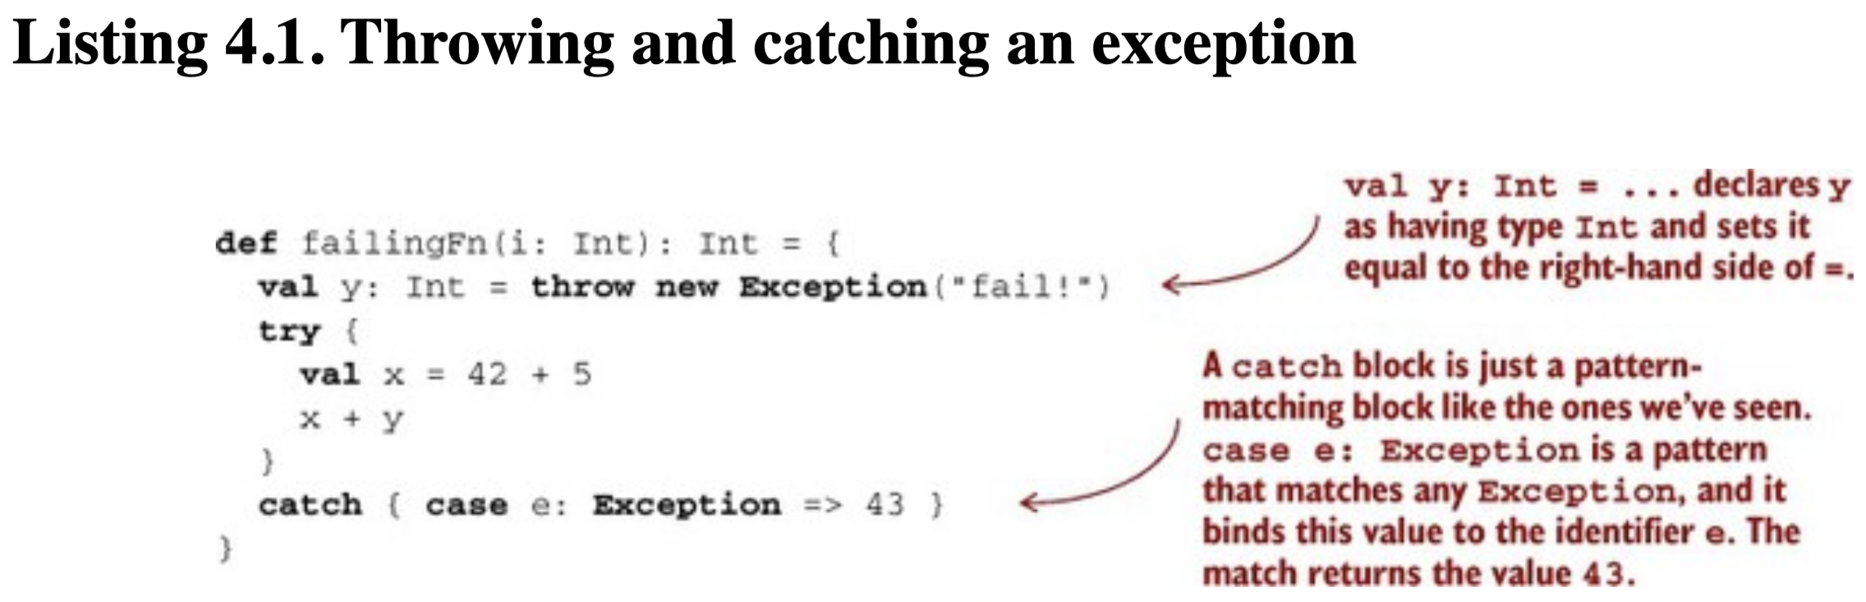
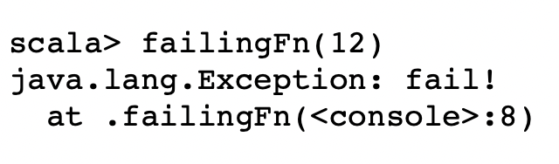
Why do exceptions break referential transparency?
y is not referentially transparent.
An RT expression may be substituted with the value it refers to
this substitution should preserve program meaning

Slide 4
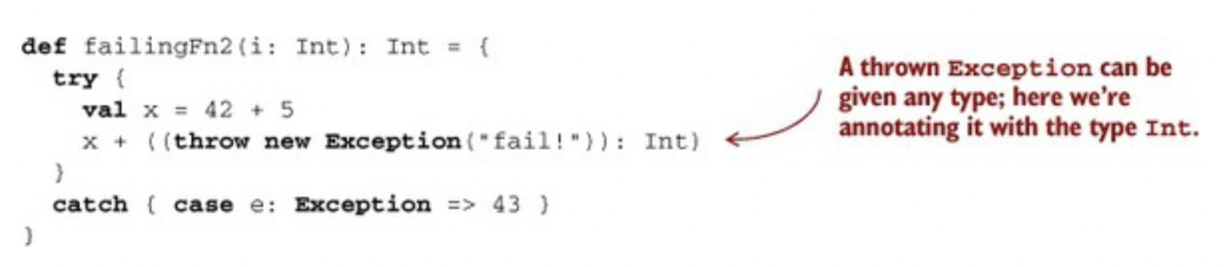
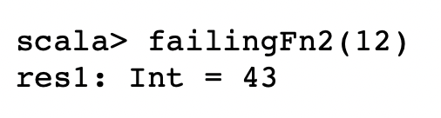
The good and Bad Aspects of Exceptions
If we substitute throw new Exception("fail!") for y in x + y,
it produced a different result,
because the exception is now raised inside a try block that will catch the exception and return 43.
RT expression does not depend on context and can be reasoned locally, whereas the meaning of non-RT expressions is context-dependent and requires more global reasoning.
The expression throw new Exception("fail") is context-dependent
it takes on different meanings depending on which try block (if any) it’s nested within.

Slide 5
Problems with Exceptions
Exceptions break RT and introduce context dependence
moving us away from the simple reasoning of the substitution model
Exceptions are not type-safe.
The type of failingFn, Int => Int tells us nothing about the fact that exceptions may occur
the compiler will certainly not force callers of failingFn to make a decision about how to handle those exceptions.
If we forget to check for an exception in failingFn,
this won’t be detected until runtime.
Notes:
Java’s checked exceptions don’t work for higher-order functions.

Slide 6
The Technique
Exceptions allow us to consolidate and centralize error-handling logic
The technique is based on an old idea:
instead of throwing an exception
we return a value that indicates an exceptional condition
There’s a new generic type
for these “possibly defined values”,
and use of higher-order functions to encapsulate common patterns of handling errors.
Completely type safe
full assistance from the type-checker in forcing us to deal with errors
Notes:
This idea might be familiar to anyone who has used return codes in C to handle exceptions.

Slide 7
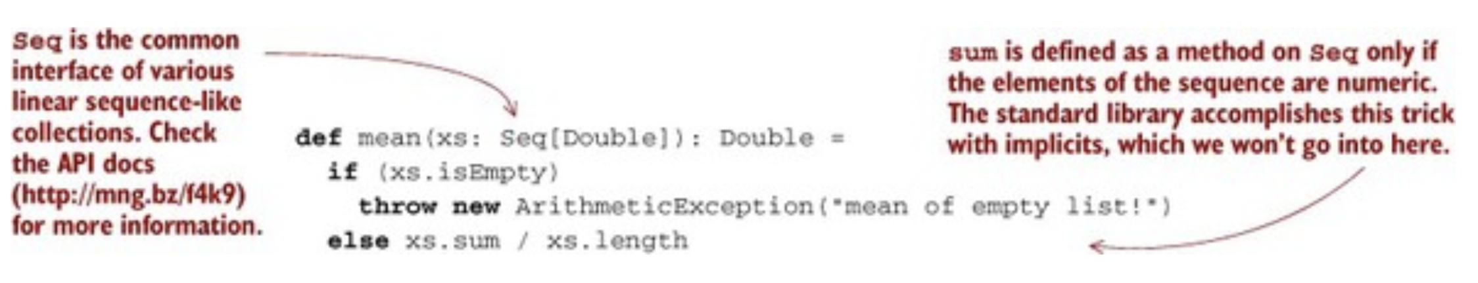
Possible Alternatives
First possibility:
Return a bogus value of type Double.
Either 0.0/0.0 –> Double.Nan or other sentinal value
Return Null – instead of the value of the needed type.
We reject this solution.
Notes:
The mean function is an example of what’s called a partial function:

Slide 8
Reasons for Rejection: for simply returning a value
the caller can forget to check this condition and won’t be alerted by the compiler, thus affecting the subsequent code.
It results in a fair amount of code at all sites
With If statements to validate whether the caller has received the correct result.
It is not applicable to polymorphic code.
def max[A](xs: Seq[A])(greater: (A,A) => Boolean): A
If the input is empty, we can’t invent a value of type A.
Nor can null be used here, since null is only valid for non-primitive types (Double, Int)
Defining policies for the function/method callers to deal with the result.

Slide 9
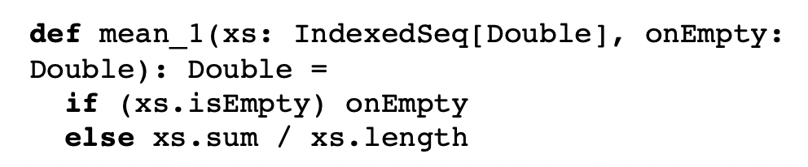
Second Possiblity & it’s rejection
Force the caller to supply an argument that tells us what to do in case the method doesn’t know how to handle the input.
A total function, but with drawbacks:
The immediate caller should have direct knowledge of how to handle undefined cases and limit (the result) to returning Double.
What if we want to handle larger computations, and abort in case of undefined mean?
Or, we want to take a different logical branch.

Slide 10
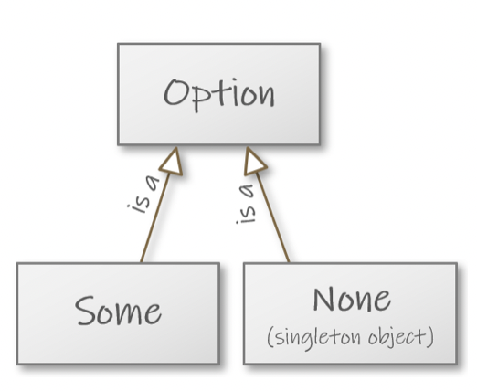
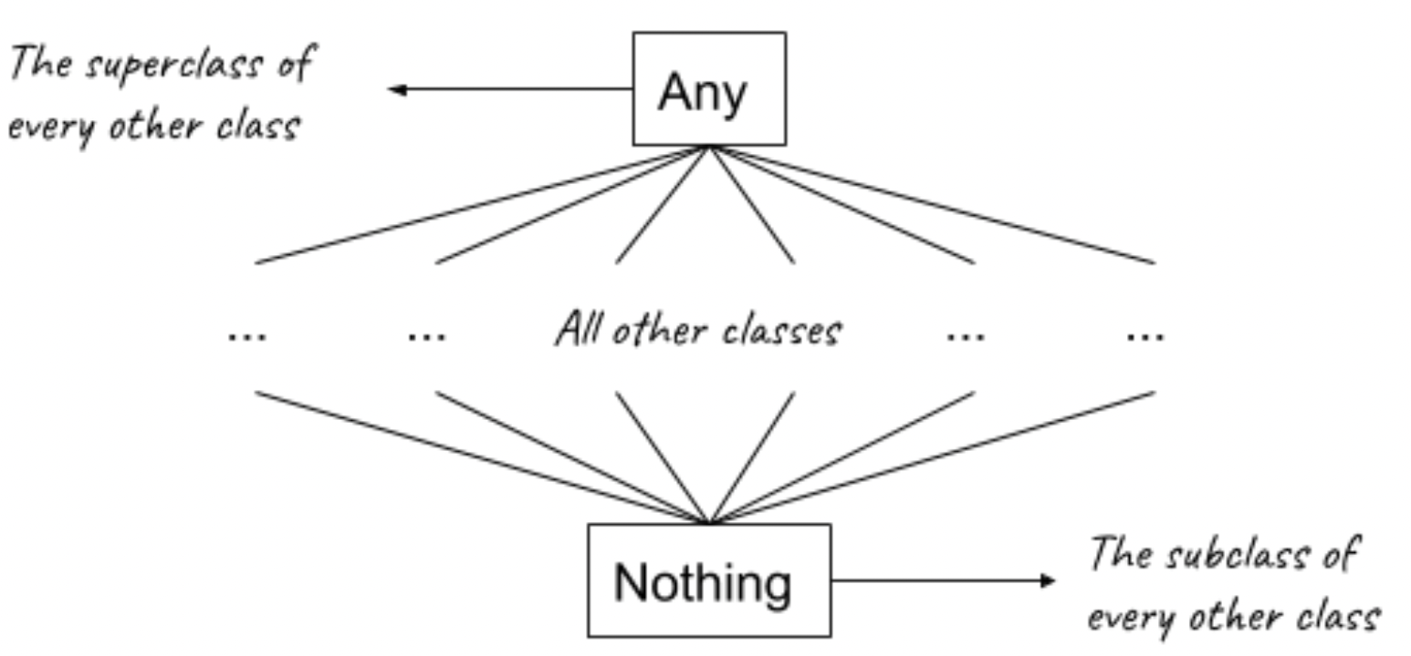
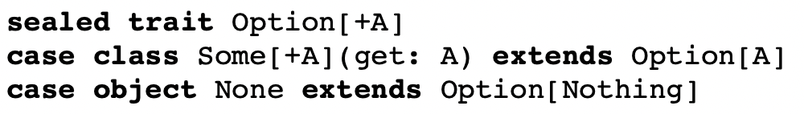
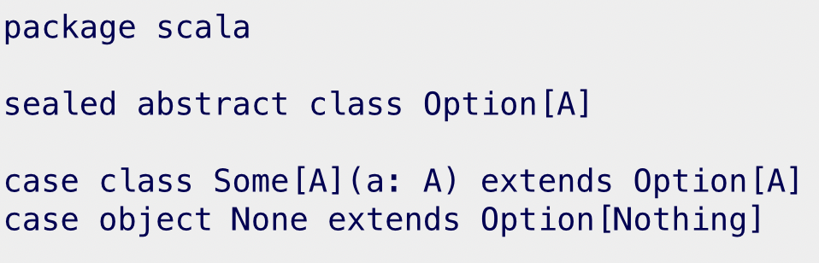
Option type
The solution is to represent explicitly in the return type that a function may not always have an answer.
Scala library provides a type, Option.
Can be thought of like a List,
But contains only one element.
Option has two cases:
Some – defined (or have something)
None – undefined (has nothing)
https://plus.cs.aalto.fi/o1/2022/w07/ch05/
Notes:
We’ll recreate the type for our learning.
None doesn’t have a type parameter, but it extends Option[Nothing]

Slide 11
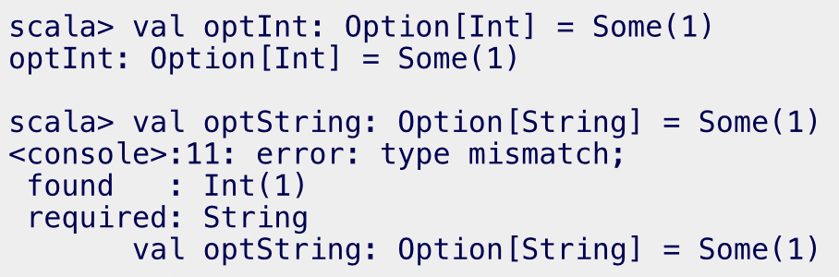
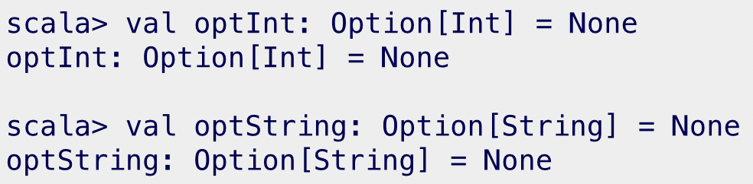
Option type
Some[A] is an implementation of Option[A]
Some[Int] is a valid implementation for Option[Int]
Not for Option[String]
None doesn’t have a type parameter
None extends Option[Nothing]
It is valid
because Nothing is a subclass of every other class.

Slide 12
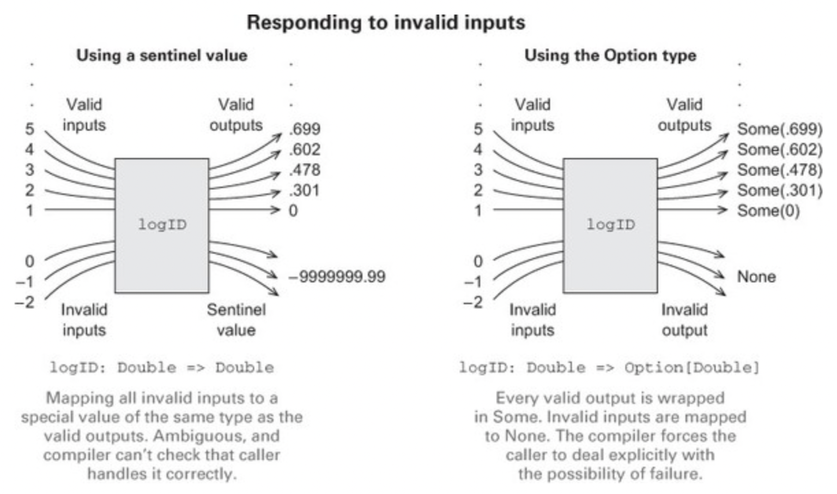
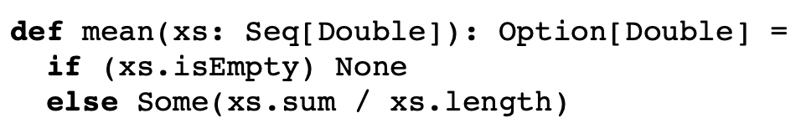
Option type
Using Option for the mean method
The return type now reflects the possibility that the result may not always be defined.
We still always return a result of type Option[Double]

Slide 13
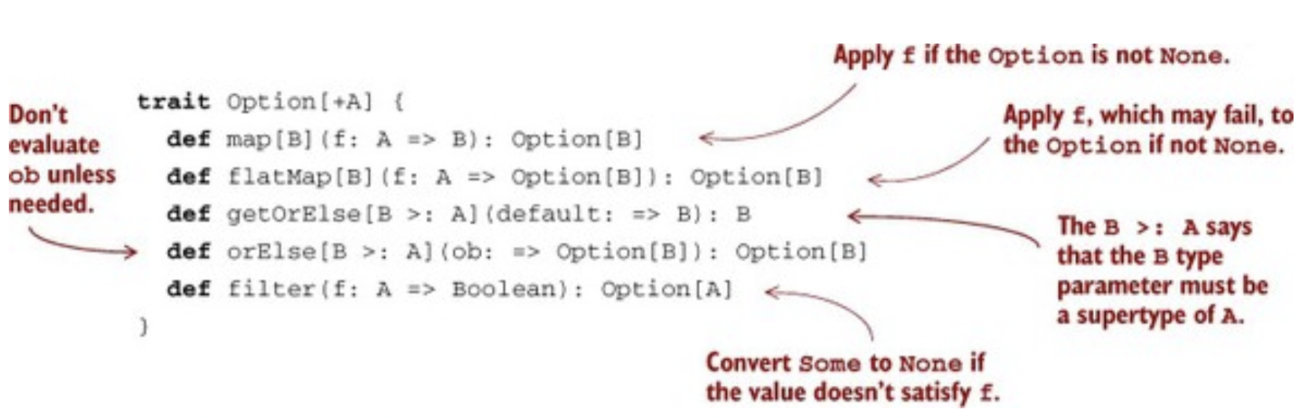
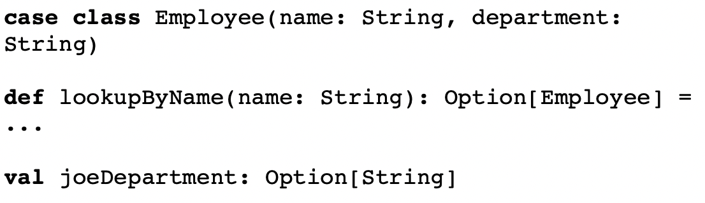
Basic Functions on Option
Option is used throughout Scala standard library [Lecture 4]
indicates that the argument is of type B, but won’t be evaluated until it’s needed by the function.
[it relates to the concept of non-strictness]

Slide 14
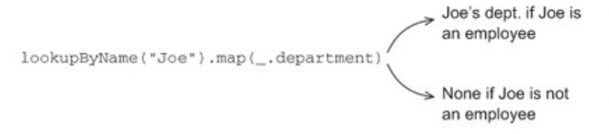
User Scenarios on Option
lookupByName("Joe") returns an Option[Employee]
Transforming using map to pull out the Option[String] representing the department.
No need to explicitly check the result of lookupByName("Joe")
simply continue the computation as if no error occurred, inside the argument to map.
If it returns None, this will abort the rest of the computation
map will not call the _.department function.

Slide 15
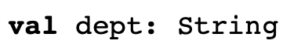
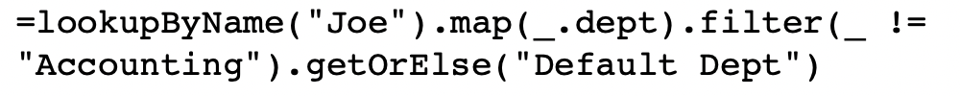
User Scenarios on Option
Using filter to convert successes into failures (only a learning-case)
if the successful values don’t match the given predicate.
A common pattern is to
transform an Option via calls to map, flatMap, and/or filter
Then, use getOrElse to do error handling at the end.
getOrElse is used here to convert from an Option[String] to a String

Slide 16
Option type: error handling
Returning errors as ordinary values can be convenient
The use of higher-order functions enables achieving the same sort of consolidation of error-handling logic we would get from using exceptions.
No need to check for None at each stage of the computation
we can apply several transformations and
Then, check for and handle None when we’re ready.

Slide 17

References
Hunt, J. (2018). A Beginner’s Guide to Scala, Object Orientation and Functional Programming. In A Beginner’s Guide to Scala, Object Orientation and Functional Programming. Springer International Publishing. https://doi.org/10.1007/978-3-319-75771-1
Chiusano, P., & Bjarnason, R. (2014). Functional Programming in Scala. Manning publications.
Sfregola, D. (2021). Get Programming with Scala. Manning.

